Slide 1


The Constitution of India: Empowering Citizens
The Constitution of India serves as the supreme law of the land, guaranteeing fundamental rights and laying the foundation for a democratic and just society. It is a testament to the nation's commitment to equality, liberty, and fraternity.
BY:
G.Venkata Nandini-22102A040783
G.Satwika-22102A040784
G.Charvi-22102A040781
K.Vedika-22102A040833
K.Sai Malavika-22102A040838

Slide 2

Understanding the Role of Citizens
1
Active Participation
2
Respecting Rights
Citizens are the pillars of a thriving democracy, responsible for upholding the values enshrined in the Constitution.
Understanding and respecting the rights of fellow citizens fosters a harmonious and inclusive society.
3
Civic Responsibilities
4
Advocacy & Awareness
Participating in elections, paying taxes, and upholding the law are essential duties for every citizen.
Raising awareness about constitutional rights and promoting civic engagement strengthens the foundation of a democratic society.

Slide 3

Importance of Civic Education
1
Empowering Individuals
Civic education equips citizens with the knowledge and skills needed to understand their rights and responsibilities.
2
Promoting Active Citizenship
Educated citizens are more likely to participate in democratic processes and contribute to societal progress.
3
Building a Strong Democracy
Civic education fosters a sense of national unity and promotes a shared understanding of constitutional values.

Slide 4
Educators as Agents of Change
Role of Educators
Teaching Methodology
Building Future Leaders
Educators play a crucial role in shaping young minds and instilling civic values.
Engaging and interactive teaching methods can make learning about the Constitution more accessible and relevant to students.
Educators have the power to inspire future generations to become responsible and informed citizens.
They can introduce constitutional principles, promote critical thinking, and encourage active participation.
By fostering a deep understanding of the Constitution, they empower students to contribute to a more just and equitable society.
This can include real-life examples, case studies, and discussions about current events.

Slide 5





Developing Engaging Video Content
Storytelling
Use compelling narratives and relatable characters to make constitutional principles engaging.
Visual Appeal
Incorporate high-quality visuals, animation, and graphics to capture attention and enhance understanding.
Interactive Elements
Include quizzes, polls, and call-to-actions to encourage participation and active learning.
Accessibility
Ensure videos are accessible to diverse audiences by using subtitles, closed captions, and sign language interpretation.

Slide 6





Reaching the Masses through Multimedia
Social Media Platforms
Mobile Apps
Utilize platforms like YouTube, Facebook, and Instagram to reach a wider audience.
Develop interactive mobile apps that provide easy access to constitutional information.
Community Outreach
Traditional Media
Organize screenings and workshops in local communities to promote awareness and engagement.
Utilize newspapers, radio, and television to disseminate information about the Constitution.

Slide 7

Collaborative Efforts for Awareness
Government
NGOs
Educational Institutions
Media Organizations
Policy Support
Grassroots Awareness
Curriculum Development
Dissemination of Information

Slide 8
code:
import java.util.Scanner;
public class ConstitutionOfIndia {
private static final String[] FUNDAMENTAL_RIGHTS = {
"1. Right to Equality: Prohibits discrimination on grounds of religion, race, caste, sex, or place of birth.",
"2. Right to Freedom: Includes freedom of speech, assembly, association, movement, residence, and profession.",
"3. Right against Exploitation: Prohibits human trafficking, forced labor, and child labor.",
"4. Right to Freedom of Religion: Ensures religious freedom and secularism.",
"5. Cultural and Educational Rights: Protects the rights of minorities to conserve their culture and establish educational institutions.",
"6. Right to Constitutional Remedies: Allows citizens to move courts to enforce Fundamental Rights."
};
private static void displayRights() {
System.out.println("\nThe Constitution of India - Fundamental Rights:"); for (String right : FUNDAMENTAL_RIGHTS) {
System.out.println(right); }
System.out.println("\nBe informed, empowered, and responsible. Jai Hind!");
}
public static void main(String[] args) {
Scanner scanner = new Scanner(System.in);
System.out.println("Welcome to the Citizen Empowerment Program!");
System.out.println("Learn about your Fundamental Rights under the Indian constitution.”)
while (true) {
System.out.println("\nMenu:");
System.out.println("1. View Fundamental Rights");
System.out.println("2. Exit");
System.out.print("Enter your choice: ");
int choice = scanner.nextInt();

Slide 9
switch (choice) {
case 1:
displayRights();
break;
case 2:
System.out.println("Thank you for using the Citizen Empowerment Program. Jai Hind!");
scanner.close();
return;
default:
System.out.println("Invalid choice. Please try again.");
}
}
}
}

Slide 10
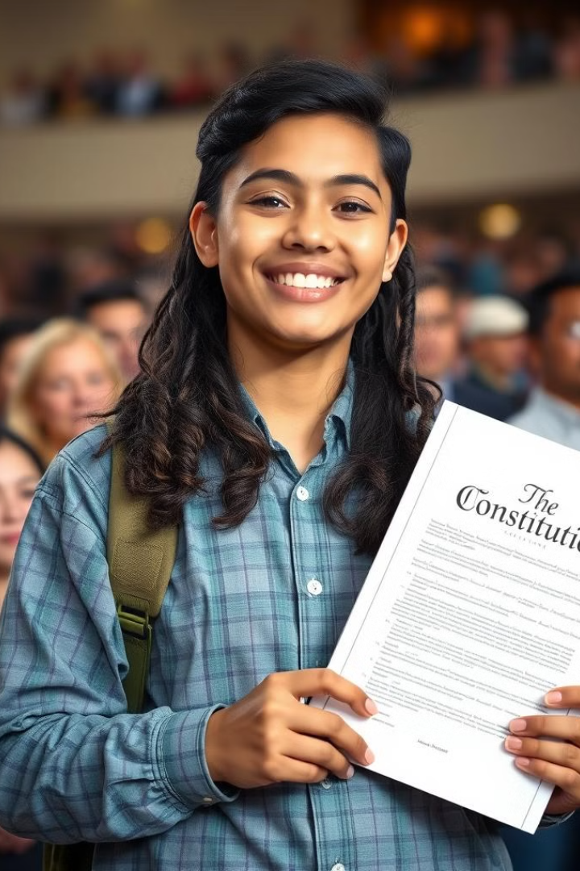
Conclusion and Call to Action
Understanding the Constitution empowers citizens to actively participate in building a just and equitable society. Let us all strive to be informed and responsible citizens, upholding the values enshrined in our fundamental law.

